Slide 1


CAPSTONE PROJECT
Automated SIM Recycling Pipeline
Project by: Philemon Langat, Daniel Kimani & Simeon Awitti

Slide 2

Project| Guide
Project Background & Solution Summary
Objectives
Benefits
Scope and workplan
Solution Design
Algorithms and Techniques
Conclusion

Slide 3
Project Background & Solution Summary
Introduction
The proposed project aims to develop an automated pipeline that recycles customer information after SIM cards are recycled and restored. The objective is to prevent customer complaints and ensure seamless access to products and services. By addressing the problem of products still being registered to previous SIM card owners, we aim to enhance customer satisfaction and streamline the customer experience. The project will involve designing and implementing a robust solution that efficiently manages customer information and ensures its accurate transfer of an MSISDN to a new SIM card owner.

Slide 4
Project Background & Solution Summary
Problem Statement
The existing process of recycling and restoring SIM cards lacks a streamlined mechanism for recycling customer information, leading to issues where products or services remain linked to previous SIM card owners (mshwari/kcb-mpesa/hustler-fund). This creates confusion and inconvenience for customers, negatively impacting their user experience. To address this problem, we propose the development of an automated pipeline that will handle the recycling of customer information, ensuring smooth access to products and services for new SIM card owners.

Slide 5


PAGE BREAKER
COPY WILL BE PLACED HERE

Slide 6
Proposed Solution
Our proposed solution involves the creation of an automated pipeline that will efficiently manage customer information recycling. The pipeline will consist of several components, including data extraction, data cleansing, data transfer, and data verification. Through the integration of advanced technologies such as machine learning and data analytics, we will develop a robust system that accurately identifies and updates customer information, preventing any potential conflicts arising from previous ownership.

Slide 7
Objectives
Benefits
Develop an automated pipeline for recycling customer information during SIM card restoration.
Minimize customer complaints by ensuring that all products and services are correctly registered to the new SIM card owner.
Streamline the customer experience by reducing service disruptions caused by outdated customer information.
Improve operational efficiency by automating the process of updating customer records.
Reduce demand to our contact touch points (retail/call center) by ensuring that all products and services are correctly registered to the new SIM card owner.
Cost saving through recycling of pre-existing prefixes instead of buying new ones from CAK.
Streamline the customer experience by reducing service disruptions caused by outdated customer information.
Improve operational efficiency by automating the current manual process of updating customer records.

Slide 8
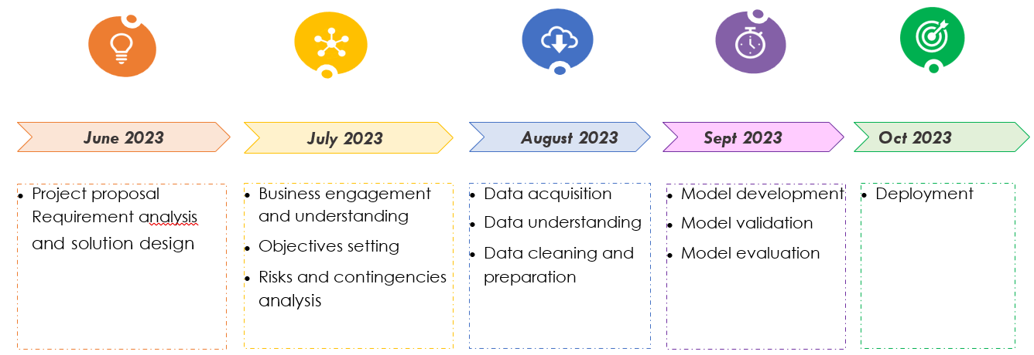
Project Delivery Timelines

Slide 9
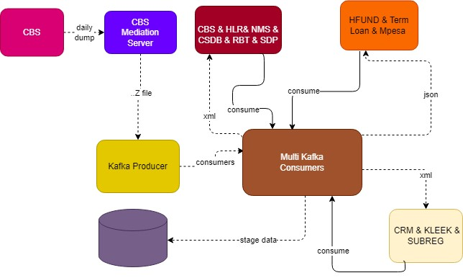
Solution Design

Slide 10

Scope and Workplan
Live Demo
Information to be archived
MSISDN
Product ID
Product name
IMSI
Date created
Created by
Date updated
Date initiated
Recycle channel
Archival status

Slide 11


